Slide 1
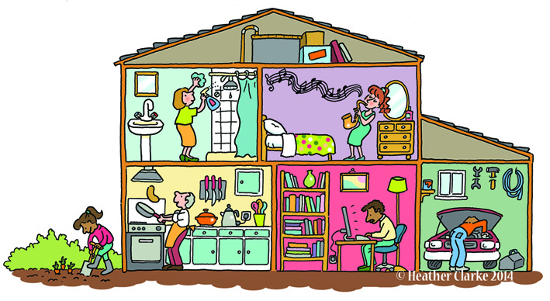
Rooms around the house

Slide 2
a room with a bath
bathroom

Slide 3
a room with a bed
bedroom

Slide 4
a room where we can have dinner
dinner
dining
sounds alike
dining room

Slide 5
a room where we can live
living room

Slide 6
a room where we can cook
kitchen

Slide 7
a place where we play and plant
yard

Slide 8
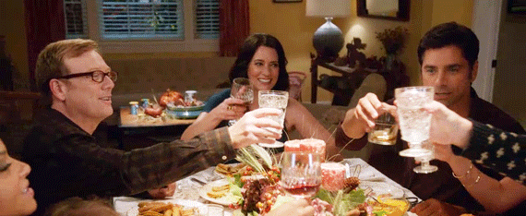
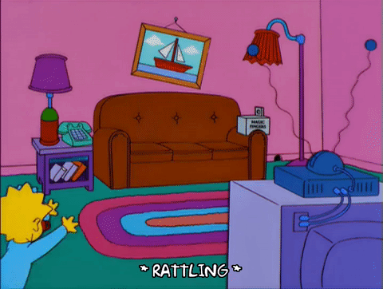
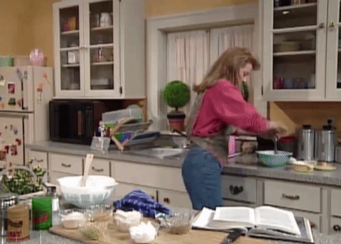
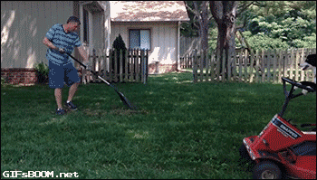
1
2
3
4
5
6

Slide 10
Game: Where in the house
Each group leader gives every member a number.
Everybody takes turns to answer the question. (correct=10 dollars / revised=5 dollars)
The rest of the group members can help to give him/her the answers.

Slide 11
Challenge Time!!!!!

Slide 12
Q1. Where in the house do you brush your teeth?

Slide 13
Q2. Where in the house do you cook food?

Slide 14
Q3. Where in the house do you sleep at night?

Slide 15
Q4. Where in the house do you eat dinner?

Slide 16
Q5. Where in the house do you sit with your family and watch TV?

Slide 17
Q6. Where do you see grass?

Slide 18
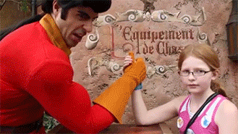
Harder Challenge!!!!!

Slide 19
Q7. Where are your books, toys and games?

Slide 20
Q8. Where are the dishes washed?

Slide 21
Q9. Where can you plant the flowers?

Slide 22
Q10. Where does your family relax together?

Slide 23
Q11. Where can you get wet inside your house?

Slide 24
Q12. Where is the largest table for eating?

Slide 25
Parts of the House

